Slide 1
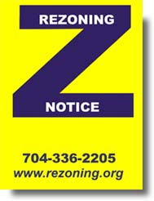

Rezoning 101
Understanding Zoning and Charlotte’s Rezoning Process
Nick Tosco
MCB Annual Review CLE
February 1, 2024

Slide 2

Agenda
What is Zoning?
  Background
  The Zoning Ordinance
  The Zoning Map
What is Rezoning?
  Background
  Types of Rezoning
How Do You Rezone in Charlotte?
  Timing
  Participants
  Process
Questions?

Slide 3
What is Zoning?
Statutorily created regulatory tool for local governments
It’s the Law!
Purpose = balance individual v. public interests

Slide 4
What is Zoning?
Zoning arrives in the 1920s
First Charlotte zoning ordinance = 1947 (officially)

Slide 5
Charlotte’s first Zoning Ordinance and Map in 1947 had five zoning districts:
Single Family (green)
Multifamily (blue)
Central Business District (red stripe)
Neighborhood Business (red)
Industrial (yellow).

Slide 6
What is Zoning?
Authority = State statute (N.C. Gen. Stat. 160D-702)
Zoning is optional, but must be consistent with State law.

Slide 7
What is Zoning?
The Zoning Ordinance
Rules/regulations for each zoning district
Unified Development Ordinance (UDO) = compendium of land use ordinances

Slide 8
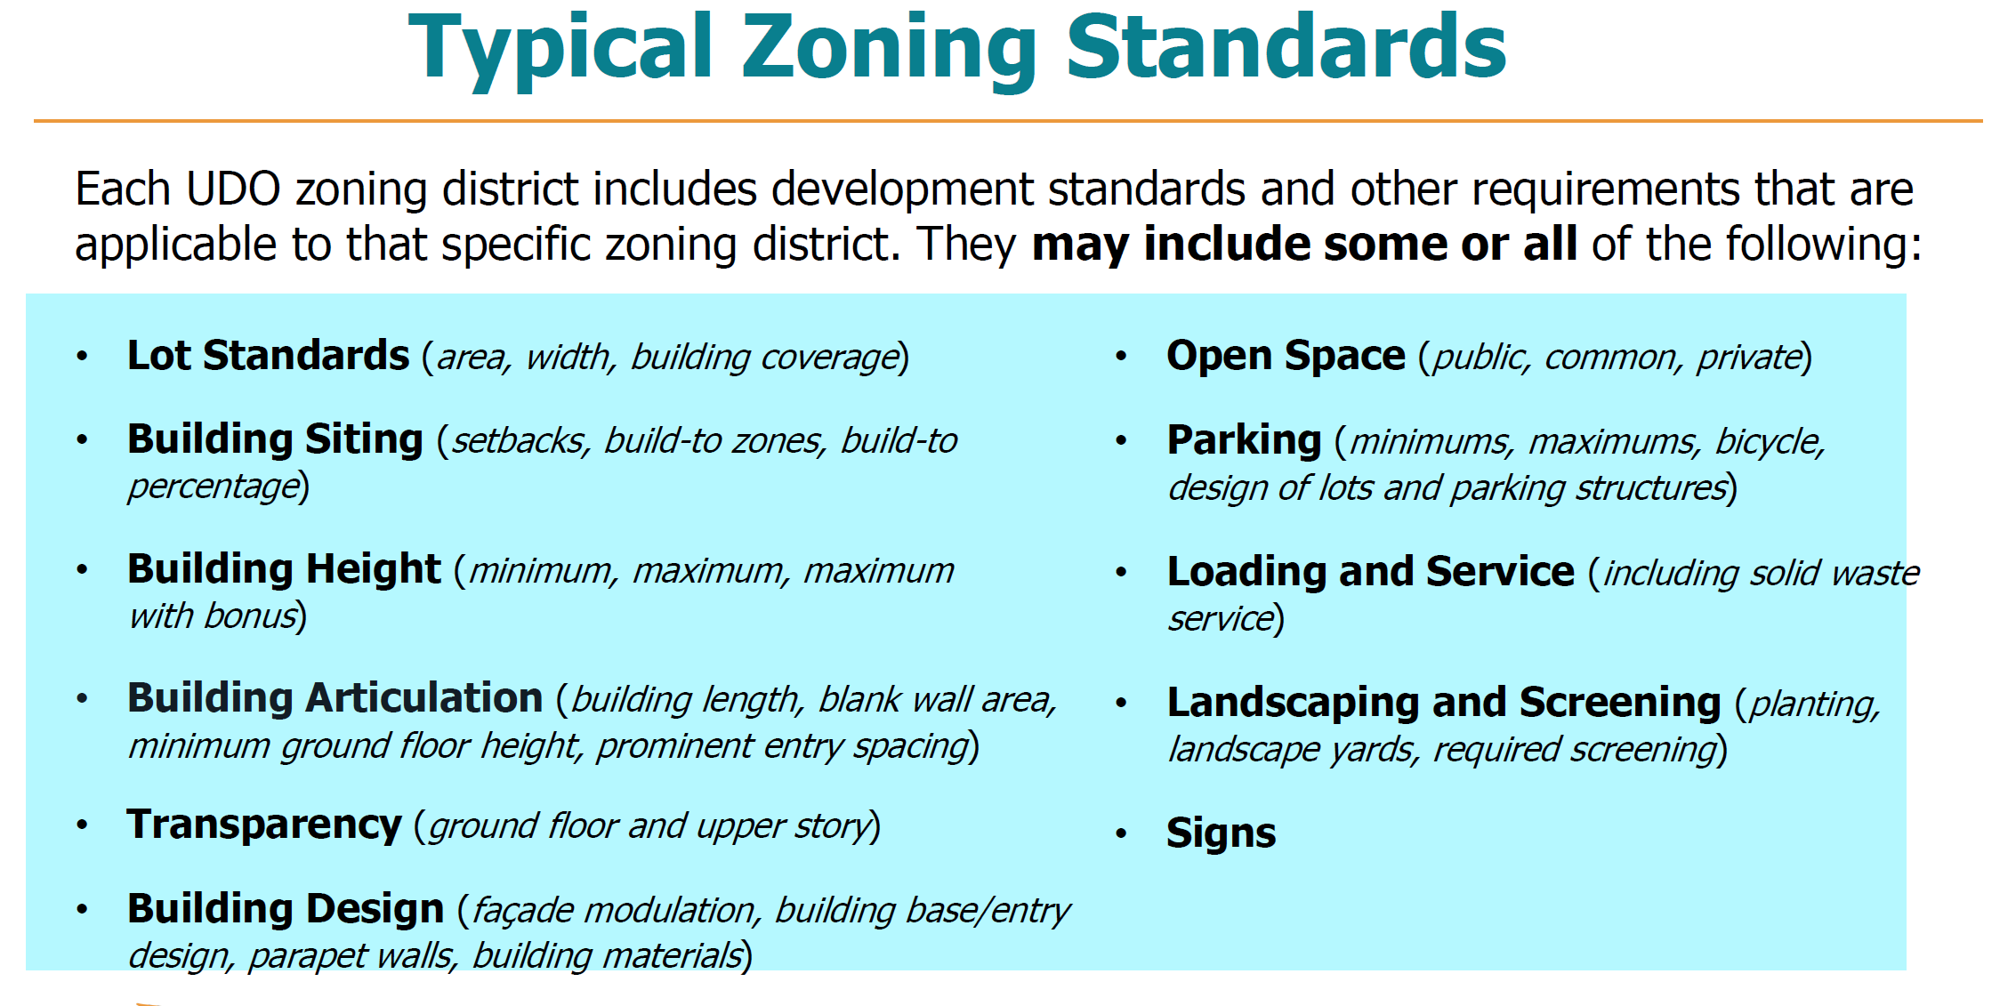
What is Zoning?

Slide 9
Setbacks and side/rear yards are measured from the right of way or adjoining parcels.

Slide 10
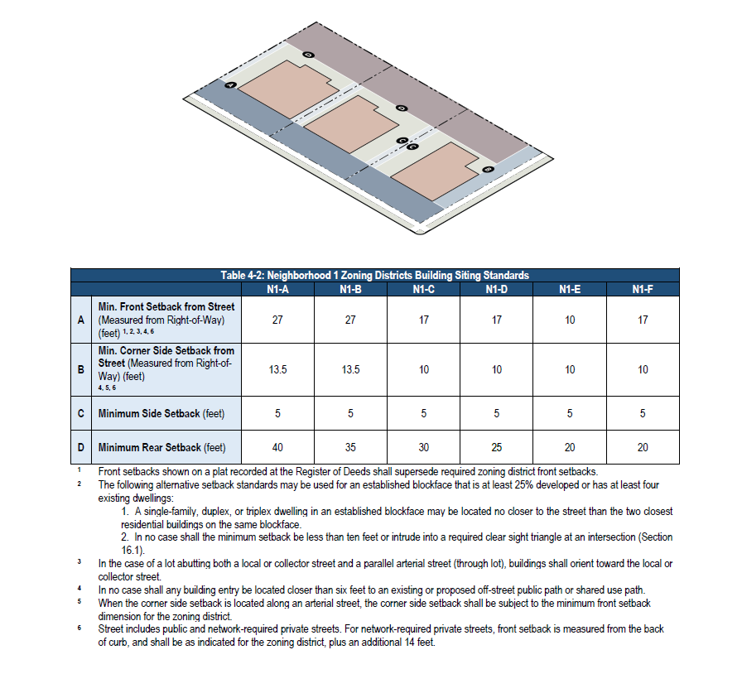

Slide 11
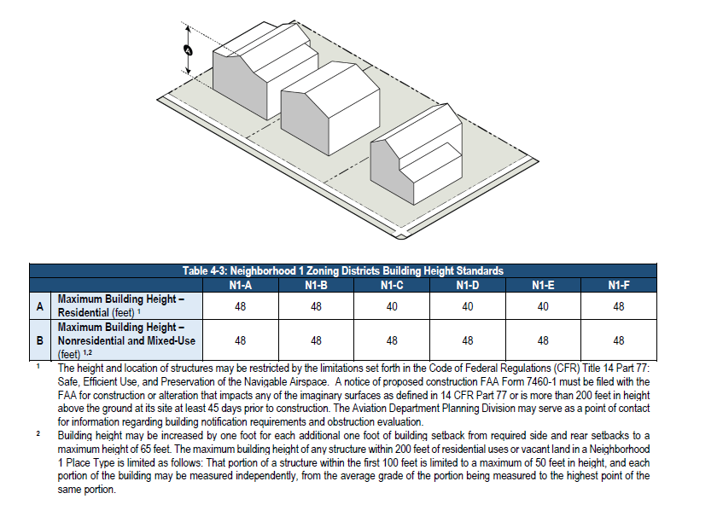

Slide 12
The required width of a buffer and the number of planted trees or
bushes varies depending on the size of the property as well as the type of adjacent uses or structures.

Slide 13
OFF STREET PARKING

Slide 14
What is Zoning?
The Zoning Ordinance
Permitting provisions:
    Special Use Permits
    Building Permits
    Certificate of Occupancy

Slide 15
What is Zoning?
The Zoning Ordinance
Miscellaneous provisions:
    Appeals
    Variances
    Text Amendments

Slide 16
What is Zoning?
The Zoning Ordinance
What is not in the Zoning Ordinance?
    Construction standards
    Minimum Housing standards
    Noise standards

Slide 17
What is Zoning?
The Zoning Ordinance
The zoning districts.
Uses
    “uses by right”
    “uses permitted under prescribed conditions”
    “permitted accessory structures”
Table of Uses

Slide 18
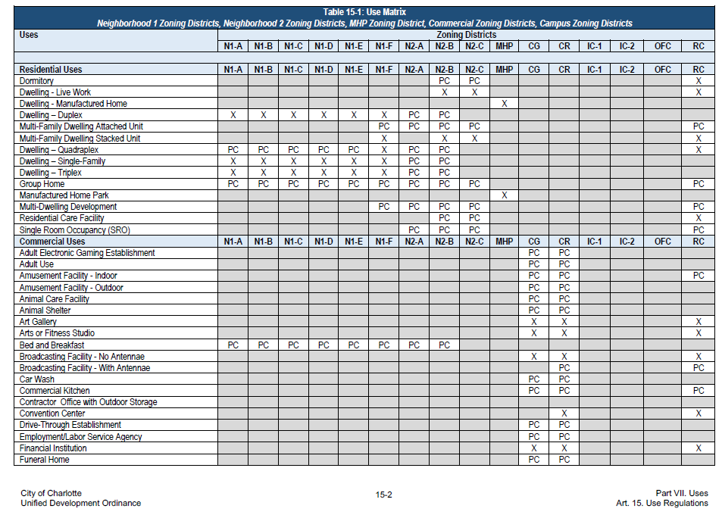

Slide 19
What is Zoning?
The Zoning Map
Official map that delineates the zones or zoning districts for the city.
Incorporated into the Zoning Ordinance by reference.
Uses color coding and abbreviations.
Usually superimposed as a map layer on the County’s online GIS system.

Slide 20
Charlotte’s Zoning Map: https://charlotte.maps.arcgis.com/apps/webappviewer/index.html?id=8165469c20914851a64e8ad10ec97bda

Slide 21
What is Rezoning?
Changing/amending the official zoning map
Local and State rules apply

Slide 22
What is Rezoning?
Types of Rezoning
Started simple
  Residential > Business > Industrial.
Got more complicated
  Residential/Neighborhood (N1, N2)
  Nonresidential/Employment (CG, CR, IC, OFC, ML, IMU)
  Mixed/Centers (NC, CAC, RAC, UE, UC).

Slide 23
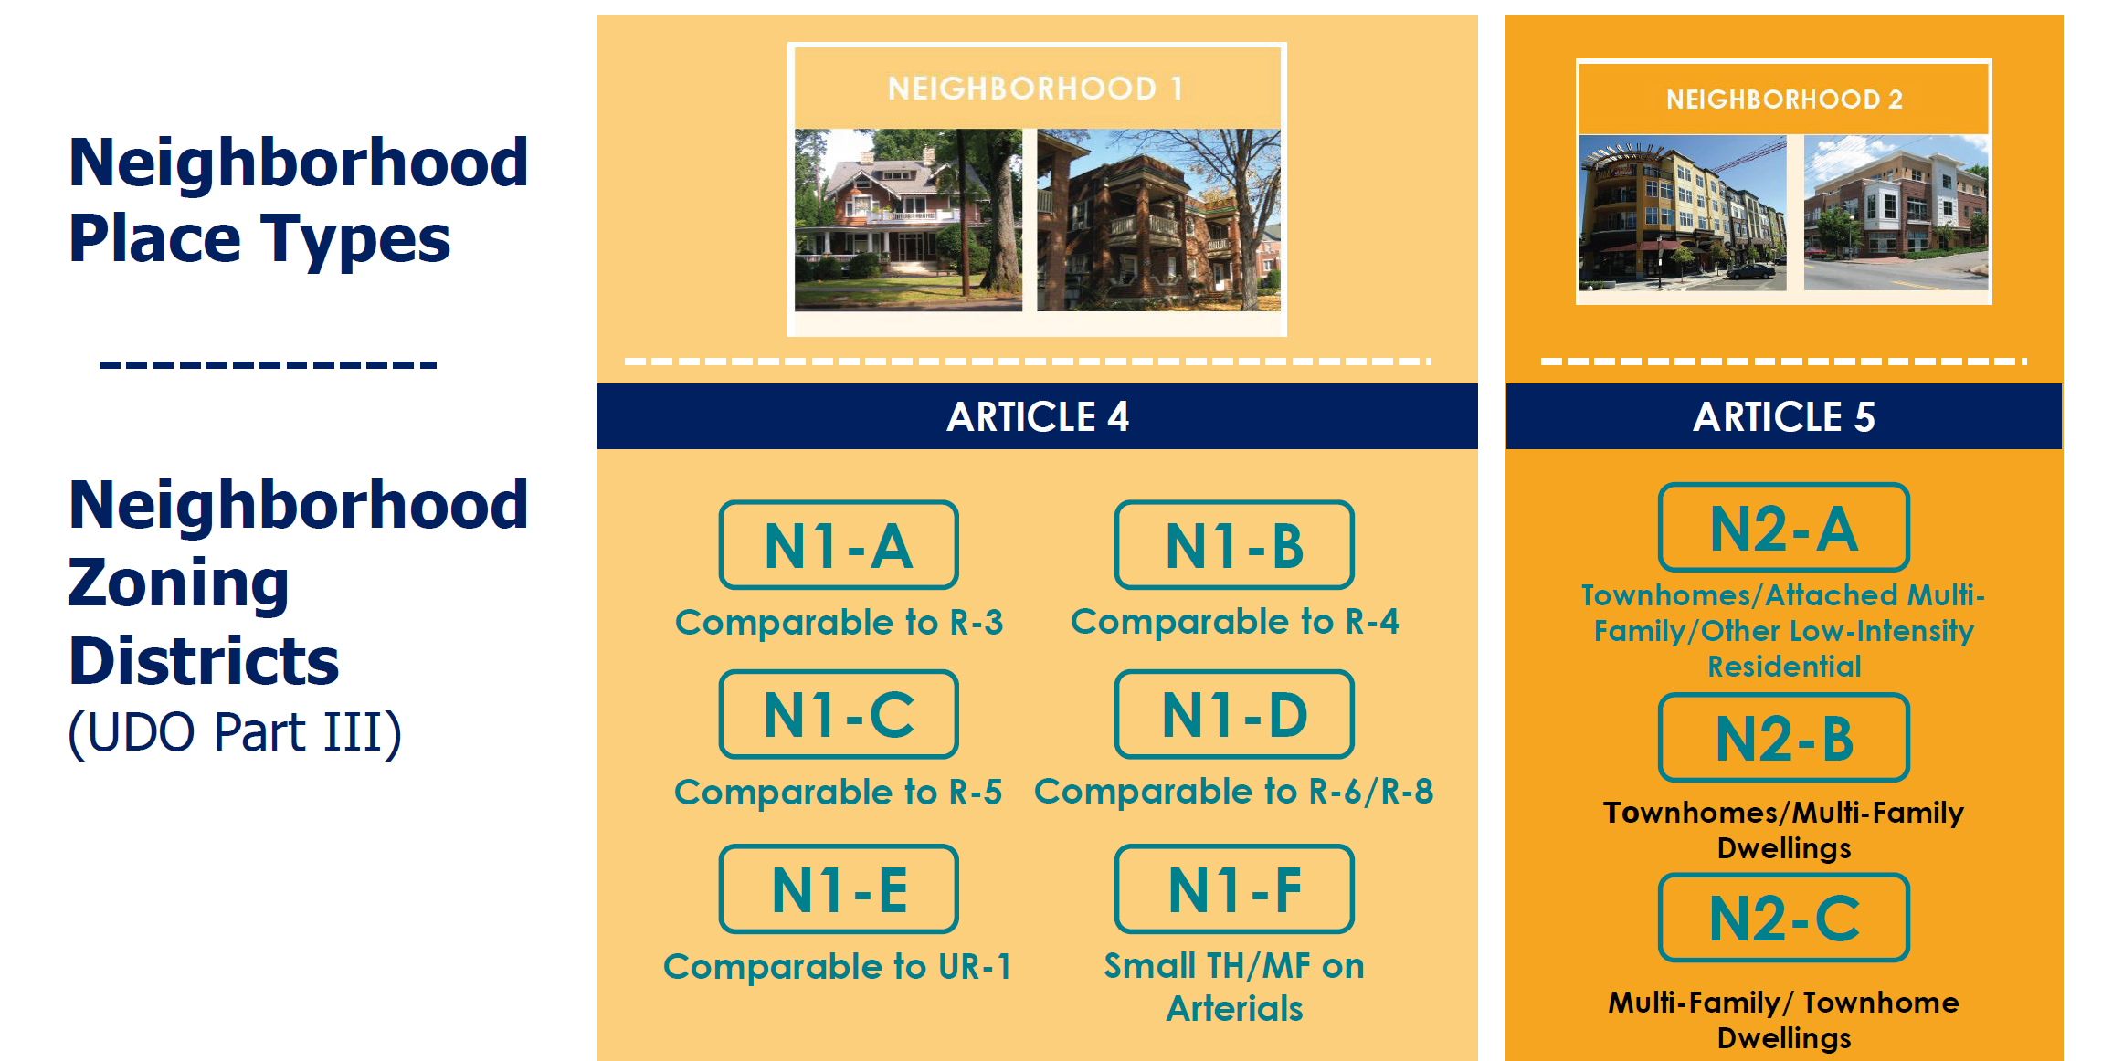

Slide 24
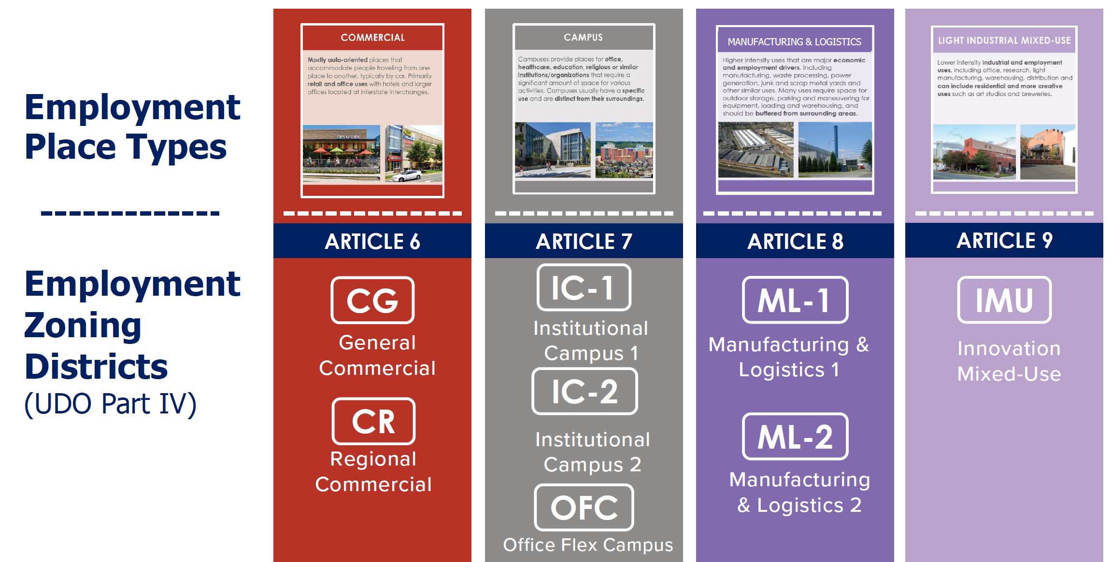

Slide 25
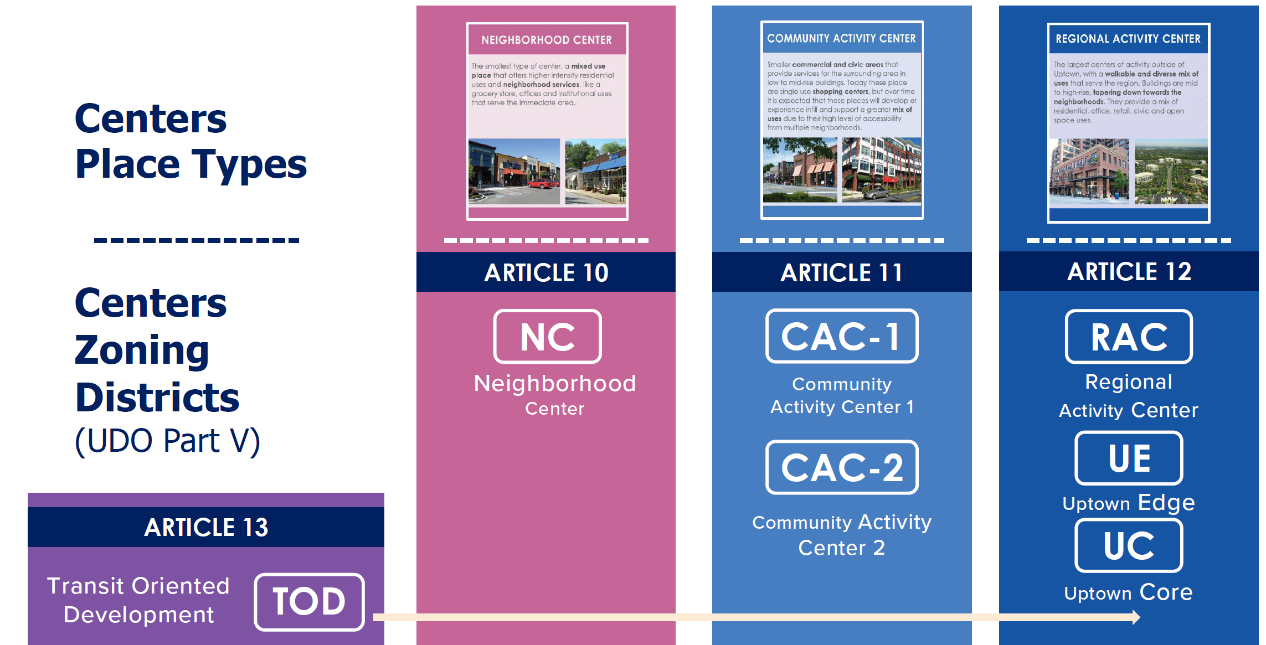

Slide 26
What is Rezoning?
Types of Rezoning
Conventional
  Rare
  Conventional v. floating
Overlay
Conditional
  Common
  Flexible
  Site specific

Slide 28
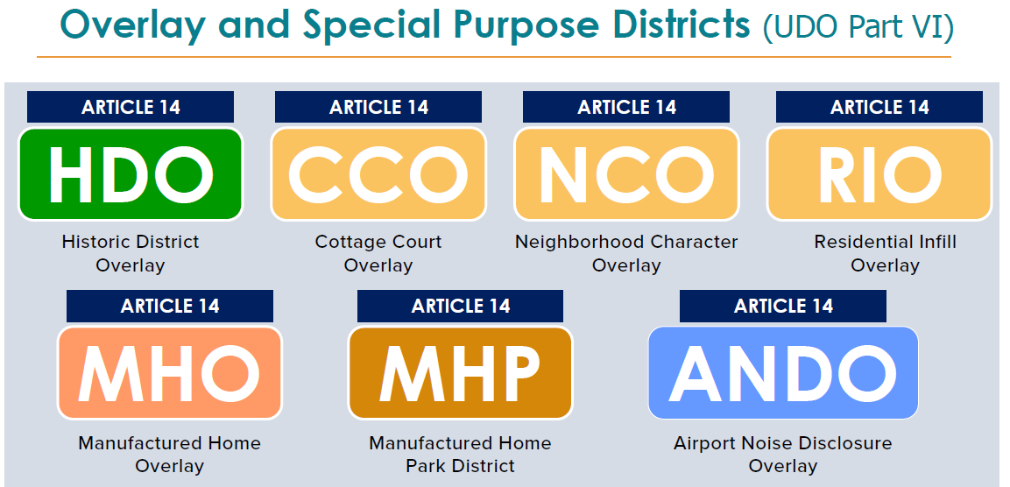

Slide 29
Overlay districts are applied over an underlying zoning district.
Conditional site plans supersede overlay districts.

Slide 30
How Do You Rezone in Charlotte?
Timing
Minimum 4-5 months
No maximum, but could be 6+ months or years
Schedule

Slide 31
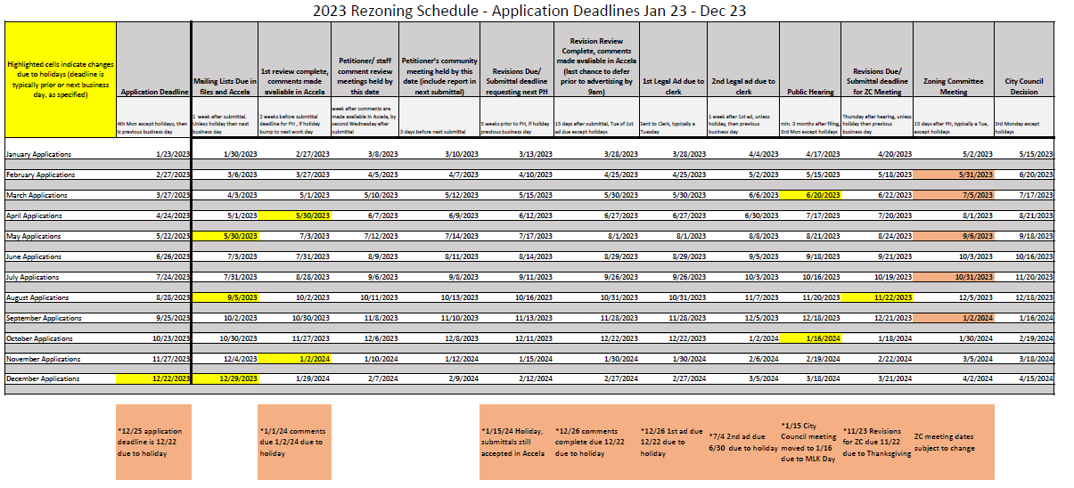

Slide 32
How Do You Rezone in Charlotte?
Participants
Petitioner’s Team
  Developer/owner
  Site designer or landscape architect
  Traffic engineer
  Zoning attorney/agent
City Staff
  Planning
  Other City Departments
Decisionmakers
  City Council
  Zoning Committee
Public
  Nearby property owners
  Businesses
  Media

Slide 33
How Do You Rezone in Charlotte?
Aldersgate Example
https://www.wsoctv.com/news/local/residents-fear-new-south-charlotte-development-will-cause-traffic-mess/944614097/

Slide 34
How Do You Rezone in Charlotte?
The Process- Presubmittal
Petitioner’s team
  Determines project scope
  Decides on rezoning
  Avoid “spot zoning”
Meeting with the City (required)
Discussions with City staff and stakeholders

Slide 35
How Do You Rezone in Charlotte?
The Process- Submittal
Application
  Acella process
Site Plan
Application Fee
  Conventional = $ 5,090
  Conditional Minor = $ 10,670
  Conditional Major = $ 13,275
Surveys/studies

Slide 38
Tip- Color code the site layout so it’s easier to understand the design of the proposed development.

Slide 39
How Do You Rezone in Charlotte?
The Process- Public Notification
Mail notices (Rezoning and Public Hearing)
Sign on Premises (Rezoning)
Website and Nextdoor (Rezoning Info)
Legal notice (Public Hearing)
Legal ad (Public Hearing)

Slide 40
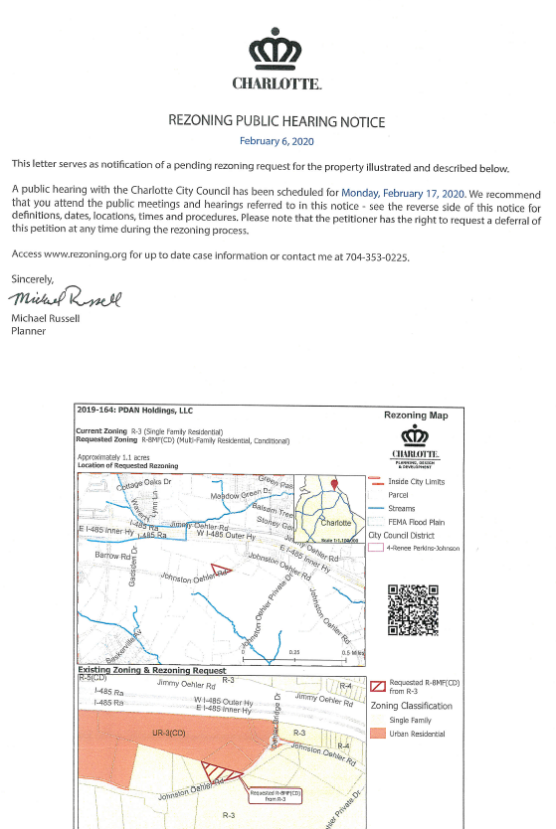

Slide 41
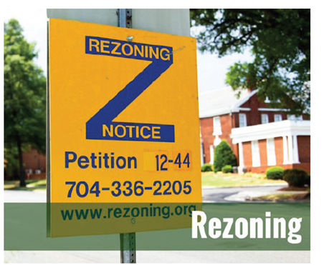

Slide 42
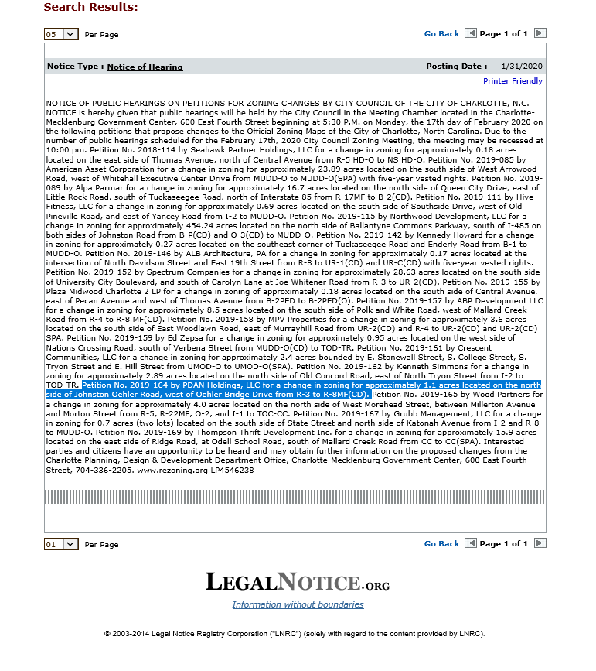

Slide 43
Website- HTTP://Rezoning.org/

Slide 44
How Do You Rezone in Charlotte?
The Process- Community Meetings
Community Meeting Guidelines
Mailed notice (10 days prior)
Invite Councilmember
Location and time important
Summary Report

Slide 49
How Do You Rezone in Charlotte?
The Process- City Review and Meetings
City Departments conduct reviews
  Memos
  Site plan comments
  Avoid “spot zoning”
Revisions and Resubmittals
Staff Analysis with City staff’s recommendation

Slide 53
How Do You Rezone in Charlotte?
The Process- Public Hearing
City Council conducts hearing (Mayor presides) and asks questions.
Staff explains site/petition and staff’s analysis
Petitioner’s team presents the petition (3 mins max, unless opposition speaks, then 10 mins max)
Tip- meet with Councilmember before public hearing

Slide 54
How Do You Rezone in Charlotte?
The Process- Zoning Committee Meeting
After the public hearing
Committee members attend public hearing
Meeting open to public, but no one from the public can speak
Committee members vote on the consistency statement and recommend approval or denial of petition

Slide 55
How Do You Rezone in Charlotte?
The Process- City Council Meeting
Council votes to approve or deny at first Zoning Council meeting after Zoning Committee meeting
Meeting open to public, but no public comments
Petitioner’s team and public can lobby beforehand
Approval stamped copy available after meeting
Any appeal/challenge must be within 60 days. See N.C. Gen. Stat. § 1-54.1.

Slide 56
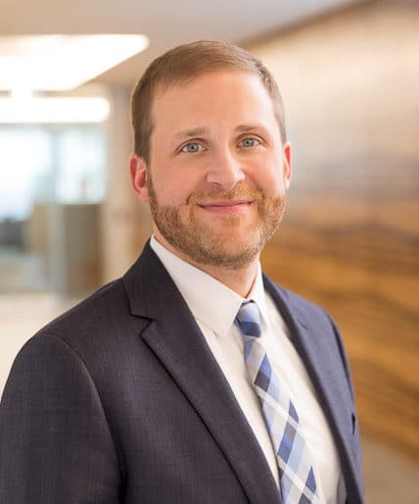


Questions ?
Nick Tosco
301 S. College Street, Suite 2900
Charlotte, NC 28202
D: 704.342.5275
F: 704.342.5264
NTosco@poynerspruill.com
www.poynerspruill.com

