Slide 1
Certiorari Appeals of Quasi-Judicial Decisions
Nick E. Tosco, Partner
2024 Zoning, Planning, & Land Use Section CLE

Slide 2
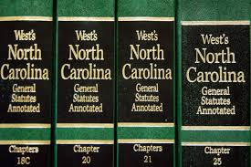
Overview of NC Statutory Authority

Slide 3
What is a Quasi-Judicial Decision? Defined in G.S. § 160D-102(28)
A decision made by a local government board
Applying a development ordinance or regulation to findings of facts
That requires the exercise of discretion on the part of the local board

Slide 4
Who makes the QJ Decision?
Board of Adjustment
Governing Board
Historic Preservation Commission
Appeals of administrative decisions
Special use Permits
Certificates of Appropriateness
Variances
Other QJ Decisions

Slide 5
How is a QJ Decision made?
Materials transmitted to local board by staff for evidentiary hearing, which form part of hearing record.
Applicant, local govt., and any person with standing has right to participate as a party. Other witnesses may testify.
Board determines contested facts and applies development ordinance/regulation to those facts.
Written decision with findings of fact and conclusions of law approved by Board and signed by Chair.

Slide 6
How is a QJ Decision appealed? The Petition for Writ of Certiorari
The petition lays out the basis for the appeal and is filed in Superior Court where the QJ decision is made.
Appeals in the nature of certiorari are governed by G.S. § 160D-1402.
Petition must petition must state basic facts necessary to establish:
standing;
grounds of alleged error;
facts supporting any alleged conflict of interest; and
relief petitioner seeks from court.

Slide 7
Full document here

Slide 8
How is a QJ Decision appealed? The Writ of Certiorari
Upon filing petition, a proposed “writ of certiorari” must also be filed with Clerk of Superior Court
Writ is a pleading directing local govt. to prepare and certify (by a specified date) record of board’s hearing.
Clerk issues writ ordering local govt. to prepare and certify record.
Petitioner serves issued writ on all respondents following rules of service for complaints (no summons required).

Slide 9
Full document here

Slide 10
The Stay
A party may request the court stay the execution or enforcement of the QJ decision pending superior court review.
Stays granted for local govt. do not require bond or other security.
Court may grant stay (discretionary) on conditions providing security of adverse party.

Slide 11
How is a QJ Decision appealed? The Record
Transmittal of Record filed with Court
Staff report
Affidavits
Local govt. must serve within 3 days of filing Transmittal of Record
Includes all documents from meeting(s):
Exhibits/illustrations/presentations
Bound, paginated, and served on Petitioner
Minutes of the meeting(s)

Slide 12
The Record
Any party can also request that the record include:
Audio/video recordings (if available)
Transcripts (requesting party must pay the cost to prepare)

Slide 13
Full document here

Slide 14
When can a QJ Decision be appealed? Statute of Limitations
Within 30 Days of the Later of:
Effective Date
Service Date
OR

Slide 15
The Response/Answer
Local govt. and any other respondent may file a response (i.e., an answer) to the petition pursuant to G.S. § 160D-1402(f).
Common practice is to not file a response, but just the record and then deal with merits through a motion to dismiss or hearing on the petition.
However, a response must be filed and served on petitioner 30 days before the hearing on the petition if respondent contests petitioner’s standing.

Slide 16
Full document here

Slide 17
Joinder
Under 160D, joinder of a civil action challenging ordinance’s constitutionality/statutory authority/etc. with a petition is allowed.
If joined, both actions may be decided in same proceeding.
Local board need not consider ordinance’s constitutionality statutory authority.

Slide 18
Parties

Slide 19
Parties
The respondent named in a petition is the local govt.,
not the board making the QJ decision.
If petition is brought by local govt., then respondent = the board.
A petition naming the board rather than the local govt. is a failure to name a necessary party and must be dismissed.
An exception exists if the local govt. participates in the litigation, waiving the failure to join the unit itself.
If the petitioner is not the applicant, the applicant must also be named.
A petitioner may, but is not required to, name any owner or lessee of the subject property.

Slide 20
Amendment
When an error is made and necessary parties are not joined in a petition, a petitioner may amend the petition to add the proper parties.
But the amendment to add necessary parties will not relate back to the original filing.
Thus, if a necessary party is not included prior to the deadline for filing the petition, the petition will be time-barred.

Slide 21
Standing

Slide 22
Who has standing file a petition? 3 Categories (G.S. 160D-1402(c))
1) Applicant/Owner
2) Local Govt.
3) Special Damages
Applicant
The governing board for the local govt.
Individuals or groups/associations who can show they will suffer special damages distinct from the rest of the community
Property owner(s)
Leasehold interests
Option holders
Easement holders

Slide 23
How do you prove special damages?
Courts in NC have held individuals claiming they will suffer special damages must present evidence that they own affected property and that their damages are distinct from the public at large.
Petitioners (or Intervenors) must go further than vague assertions of special damages; they must provide a factual basis to support standing and allege specific facts.
Special damages may be established by affidavits or testimony.
Each case is a fact specific inquiry, but some factors do apply…

Slide 24
Factors for Determining Special Damages
Proximity
Property value
This is the most common way to establish special damages.
However, the harm must be property specific. Alleged diminution of property values in the neighborhood or larger community is insufficient to confer standing.
Adverse effects
While proximity by itself is insufficient to grant standing, it does bear some weight on the issue.
A reduction in the value of petitioner’s own property is sufficient to grant standing.
Traffic congestion
Parking overflow
Increased risk of fire
Stormwater runoff
Littering
Noise
Dust
Odor
Concerns of vandalism
Personal safety

Slide 25
Standing for Interested Groups/Associations Conditions
A legally existing organization has standing to bring suit on behalf of its members when :
Its members would otherwise have standing to sue in their own right;
The interests it seeks to protect are germane to organization’s purpose; and
The claim/relief requested doesn’t require participation of individual members

Slide 26
Standing for Interested Groups/Associations Neighborhood Groups/Associations
G.S. § 160D-1402(c)(3) provides neighborhood associations have standing, so long as two conditions are satisfied:
Normal rules for intervention (Rule 24) apply to certiorari petitions.
1) At least one of the members of the association would have individual standing; and
2) The association was not created in response to the development that is the subject of the appeal.

Slide 27
Full document here

Slide 28
Standard of Review

Slide 29
Superior Court’s Standard of Review
Superior court sits as an appellate body.
Review is based solely upon the record below.
Superior court will determine whether the QJ decision was:
1
2
3
4
5
6
In violation of constitutional rights (e.g., procedural due process rights)
In excess of statutory authority of the local govt. (e.g., preemption) or authority of the board
Inconsistent with applicable procedures specified by statute or ordinance
Affected by errors of law
Unsupported by competent, material, and substantial evidence in view of the record
Arbitrary and capricious
De Novo Review
Whole Record Review

Slide 30
De Novo Review
The superior court considers the matter anew, as if not considered by the board. The Court is not bound by the board’s decision and may freely substitute its judgment.
Whether the record contains competent, material, and substantial evidence is a conclusion of law reviewable de novo

Slide 31
Whole Record Review
The board’s findings of fact are binding on the superior court if they are supported by competent, material, and substantial evidence.
The superior court weighs the evidence that was before the board and makes determinations of credibility.

Slide 32
What is competent, material and substantial evidence?
In other words, evidence that is admissible, relevant to the issues in dispute, and sufficient to support the decision of the board.
Material
Substantial
Competent
Having some logical connection with the consequential facts
What a reasonable mind would regard as sufficiently supporting a specific result
Legally admissible (e.g., not hearsay)

Slide 33
New Evidence

Slide 34
New Evidence
The superior court must allow the record to be supplemented with affidavits, testimony, documents or evidence when the petition raises any of the following issues:
The rules of discovery apply to the supplementation of the record
Petitioner/intervenor standing
Conflicts of interest
Constitutional violations
Lack of statutory authority

Slide 35
Disposition

Slide 36
Disposition Options
After hearing from the parties and conducting a review of the QJ decision using the proper standard of review, the superior court considers the remedies available:
Affirm
Reverse (and remand to the board with instructions)
Remand for further proceedings by the board

Slide 37
Disposition Reasons to Remand
Fix procedural error
Make sufficient findings of fact such that the court can properly perform its function
Findings of fact are unnecessary when the record sufficiently reveals the basis for the QJ decision or when the material facts are undisputed
Issue or revoke an approval
Reverse a zoning enforcement action

Slide 38
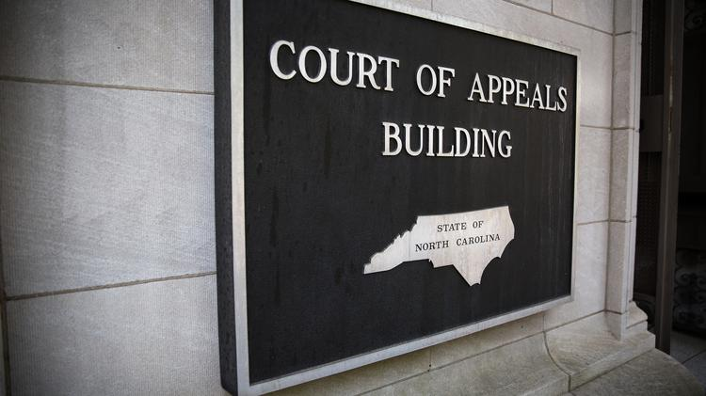
Appealing the Appeal

Slide 39
Appealing the Appeal
Superior court’s decision is appealed to the Court of Appeals just like any other superior court decision.
Notice of Appeal must be filed in superior court within 30 days after entry of superior court’s decision (unless otherwise tolled).

Slide 40
Appealing the Appeal
On appeal, the Court of Appeals determines:
Whether the superior court used the correct standard of review in reviewing the QJ decision; and
Whether it correctly applied that standard

Slide 41
Questions?
Nick Tosco
Partner
NTosco@poynerspruill.com
704-342-5275

